Slide 1

New York City neighbourhoods and their susceptibility to COVID-19
Suntharan Arunasalam

Slide 2
Introduction
The coronavirus disease 2019 (COVID-19) is an infectious disease that has resulted in a global pandemic that has affected the lives of millions of people around the world.
While the impact of this disease has been felt everywhere, some neighbourhoods have been hit harder than others.
In this project, I investigated how the proportion of different types of venues in neighbourhoods in New Yor
This investigation will be important to many stakeholders like
The government: they will be able to identify the types of neighbourhoods which require more attention
Hospitals: hospitals in such neighbourhoods can prepare themselves for a large influx of patients
Ordinary people: people living in such neighbourhoods can take the necessary precautions to avoid exposure.

Slide 3
Data
I obtained data from three sources:
The New York City government website for the covid-19 data
Opendatasoft.com for the latitude and longitude of each zip code
The Foursquare api to obtain the venues in each postcode

Slide 4
Methodology
Assigned the zip codes into 2 classes based on whether the covid case rate is below or above the median case rate
Chose three categories for the venues, namely, stores, restaurants and entertainment and found the proportion of each category in each of these postal codes
I then built a decision tree classifier, a gradient boosted classifier and logistic regression classifier based on this data
Used feature scaling for the logistic regression classifier

Slide 5
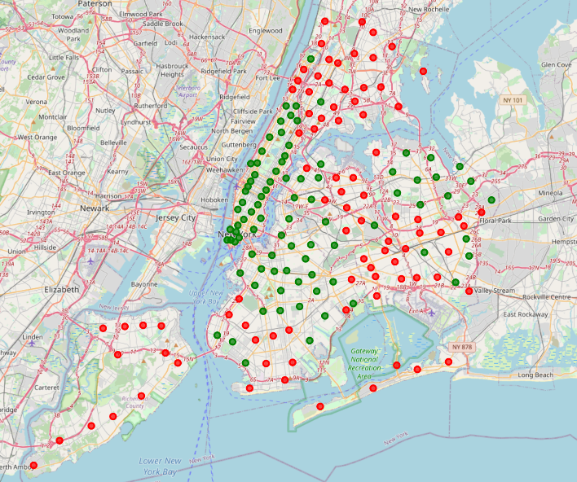
Results
Red points: regions with higher than median case rate
Green points: regions with lower than median case rate

Slide 6
Results
Here are the F1 scores of each classifier.
We see that all are above 0.5 suggesting some success.
However more data and features should be used to obtain more reliable classifiers
Classifier | F1 score
Decision tree | 0.68
Gradient boosted decision tree | 0.65
Logistic Regression | 0.59

Slide 7
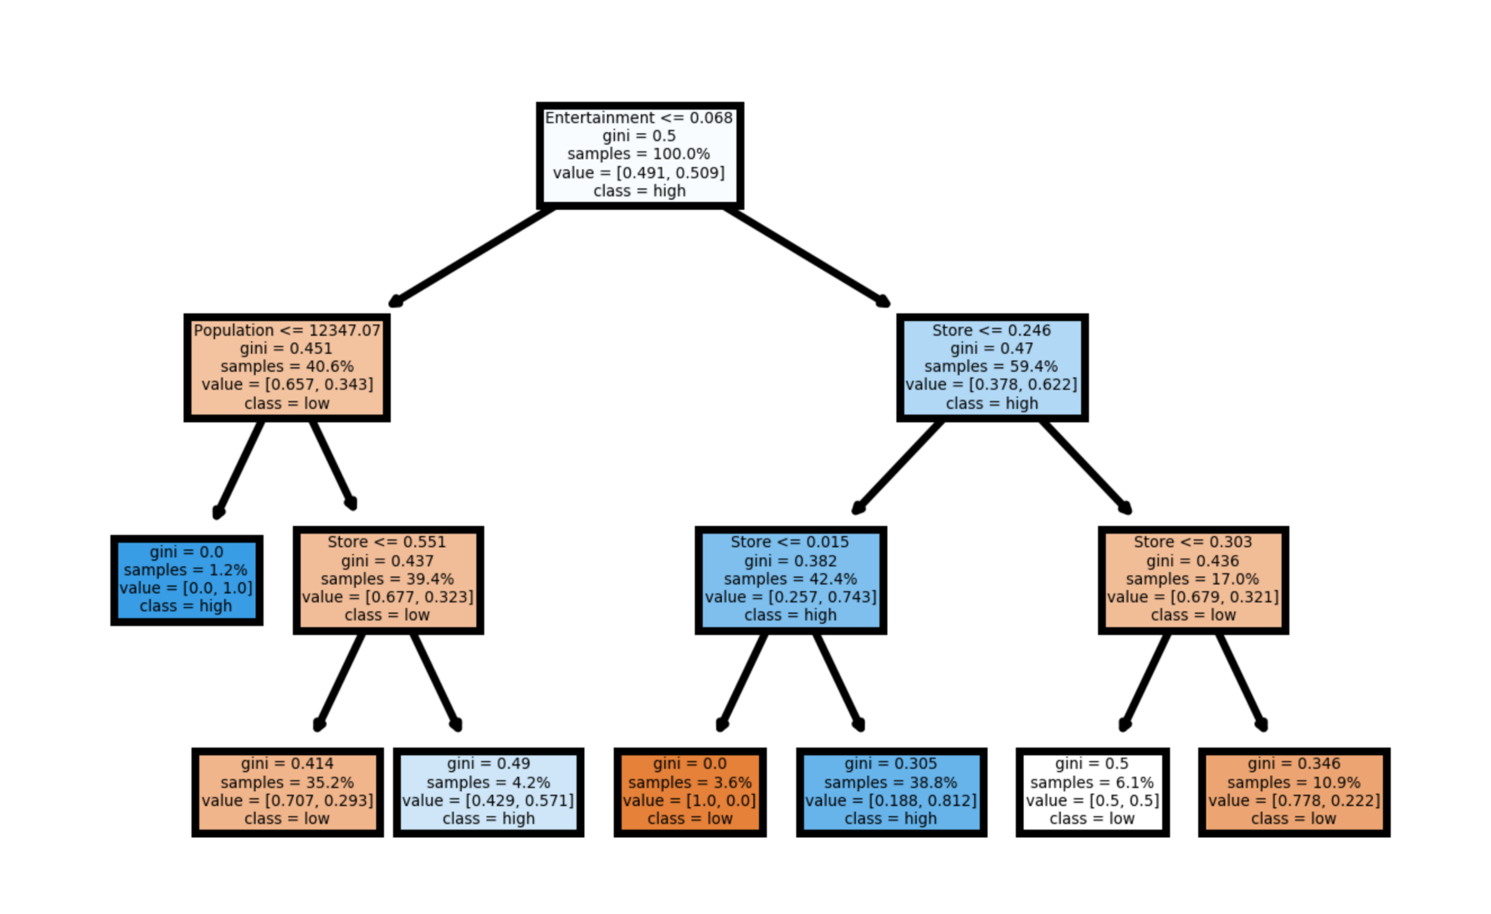
Discussion
A significant split at the root node for entertainment < 6.8%
Largest ‘high’ class has a large number of entertainment and restaurant venues
Largest ‘low’ class also has a significant restaurant proportion
Indicates that entertainment venues are the most important factor

Slide 8
Conclusion and Future work
From the analysis in this investigation, we may conclude that entertainment venues pose a significant risk for COVID transmission
Future work:
The study can be extended to other cities and countries. This allows for the collection of much more data
Differences between cities can also be studied in this way.
More features like demographic data and other venue categories can be used

